Slide 1


CSCE 692 Design Principles of Computer Architecture Lecture 5b Chap 5 – Directory-Based Cache Coherence
Dr. Scott Graham
AFIT/ENG
Notes adapted from
David Patterson
Electrical Engineering and Computer Sciences
University of California, Berkeley

Slide 2
Review
Caches contain all information on state of cached memory blocks
Snooping cache over shared medium for smaller MP by invalidating other cached copies on write
Sharing cached data ⇒ Coherence (values returned by a read), Consistency (when a written value will be returned by a read)

Slide 3
Cache Coherence System Requirements
States, state transition diagram, and actions
Coherence protocol
(1) Determine when to invoke coherence protocol
(2) Ascertain state of line (block) in other caches
Is there a need to communicate with other cached copies?
(3) Locate the other copies
(4) Communicate with those copies (invalidate/update)
(1) achieved the same way on all systems
State of the line (block) is maintained in the cache
Protocol is invoked if an “access fault” occurs on the line
Different approaches distinguished by (2) to (4)

Slide 4
Bus-based Coherence
All of (2), (3), (4) done through broadcast on bus
faulting processor sends out a “search”
others respond to the search probe and take necessary action
Could do it in scalable network too
broadcast to all processors, and let them respond
Conceptually simple, but broadcast doesn’t scale with p
on bus, bus bandwidth doesn’t scale
on scalable network, every fault leads to at least p network transactions
Scalable coherence:
can have same cache states and state transition diagram
different mechanisms to manage protocol

Slide 5
Basic Operation of Directory
• k processors.
• With each cache-block in memory: k presence-bits, 1 dirty-bit
• With each cache-block in cache: 1 valid bit, and 1 dirty (owner) bit
• Read from main memory by processor i:
• If dirty-bit OFF then { read from main memory; turn p[i] ON; }
• if dirty-bit ON then { recall line from dirty proc (cache state to shared); update memory; turn dirty-bit OFF; turn p[i] ON; supply recalled data to i; }
• Write to main memory by processor i:
• If dirty-bit OFF then { supply data to i; send invalidations to all caches that have the block; turn dirty-bit ON; turn p[i] ON; }

Slide 6
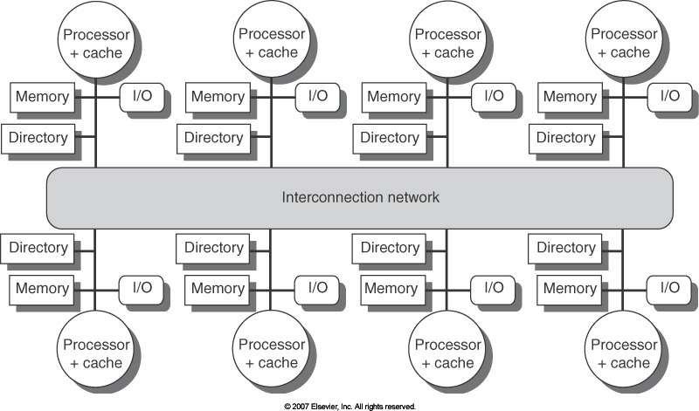
A More Realistic View

Slide 7
Scalable Approach: Directories
Every memory block has associated directory information
keeps track of copies of cached blocks and their states
on a miss, find directory entry, look it up, and communicate only with the nodes that have copies if necessary
in scalable networks, communication with directory and copies is through network transactions
Directory itself is distributed
Avoids bottlenecks
Must have unique address space

Slide 8
Directory Protocol
Similar to Snoopy Protocol: Three states
Shared: ≥ 1 processors have data, memory up-to-date
Un-cached (no processor has it; not valid in any cache)
Exclusive (Modified): 1 processor (owner) has data; memory out-of-date
In addition to cache state, must track which processors have data when in the shared state (usually bit vector, 1 if processor has copy)
Keep it simple(r):
Writes to non-exclusive data ⇒ write miss
Processor blocks until access completes
Assume messages received and acted upon in order sent

Slide 9
Directory Protocol
No bus and don’t want to broadcast:
interconnect no longer single arbitration point
all messages have explicit responses
Terms: typically 3 processors involved
Local node where a request originates
Home node where the memory location of an address resides
Remote node has a copy of a cache block, whether exclusive or shared
Example messages on next slide: P = processor number, A = address
For now assume simple consistency
Actions occur in order
Assume actions are atomic

Slide 10
Directory Protocol Messages (Fig 5.21)
Message type Source Destination Msg Content
Read miss Local cache Home directory P, A
Processor P reads data at address A
Make P a read sharer and request data
Write miss Local cache Home directory P, A
Processor P has a write miss at address A
Make P the exclusive owner and request data
Invalidate Home directory Remote caches A
Invalidate a shared copy at address A
Fetch Home directory Remote cache A
Fetch the block at address A and send it to its home directory
Change the state of A in the remote cache to shared
Fetch/Invalidate Home directory Remote cache A
Fetch the block at address A and send it to its home directory
Invalidate the block in the cache
Data value reply Home directory Local cache Data
Return a data value from the home memory (read miss response)
Data write back Remote cache Home directory A, Data
Write back a data value for address A (invalidate response)

Slide 11
Directory Protocol Messages (Fig 5.21)
Message type
Readmiss
Write miss
Invalidate
Fetch
Fetch/Invalidate
Data value reply
Data write back
Destination
Home directory
Home directory
Remote cache
Remote cache
Remote cache
Local cache
Home directory
Msg
Content
P, A
P, A
A
A
A
Data
A, Data
Source
Local cache
Local cache
Home directory
Home directory
Home directory
Home directory
Remote cache
P reads data at A
P read sharer, request data
P has write miss at A
P exclusive owner, reqst data
Invalidate shared copy at A
Fetch block at A, send to its home directory
Change state of A in remote cache to shared
Fetch block at A, send to its home directory
Invalidate block in cache
Return data from home memory (read miss response)
Write back data value for A (invalidate response)

Slide 12
State Transition Diagram for One Cache Block in Directory Based System
States identical to snoopy case; transactions very similar
Transitions caused by read misses, write misses, invalidates, data fetch requests
Generates read miss & write miss message to home directory
Write misses that were broadcast on the bus for snooping ⇒ explicit invalidate & data fetch requests

Slide 13
CPU -Cache State Machine
CPU Read hit
State machine for CPU requests for each cache block
Invalidates come from external
Invalid state if in memory
Invalidate
Shared
(read/only)
Invalid
CPU Read
Send Read Miss
message
CPU read miss:
Send Read Miss
CPU Write: Send Write Miss
msg to home directory
CPU Write: Send Write Miss message
to home directory
Fetch/Invalidate
send Data Write Back message
to home directory
Fetch: send Data Write Back message to home directory
CPU read miss: send Data Write Back message and read miss to home directory
Exclusive
(read/write)
CPU read hit
CPU write hit
CPU write miss:
send Data Write Back message
and Write Miss to home directory
Notes:
Invalid:
read => shared
write => dirty
shared looks the same

Slide 14
State Transition Diagram for Directory
Same states & structure as the transition diagram for an individual cache
2 actions: update of directory state & send messages to satisfy requests
Tracks all copies of memory block
Also indicates an action that updates the sharing set, Sharers, as well as sending a message

Slide 15
Directory State Machine
Read miss:
Sharers += {P};
send Data Value Reply
State machine for Directory requests for each memory block
Uncached state if in memory
Read miss:
Sharers = {P}
send Data Value
Reply
Shared
(read only)
Uncached
Write Miss:
Sharers = {P};
send Data
Value Reply
msg
Write Miss:
send Invalidate
to Sharers;
then Sharers = {P};
send Data Value
Reply msg
Data Write Back:
Sharers = {}
(Write back block)
Write Miss:
Sharers = {P};
send Fetch/Invalidate;
send Data Value Reply
msg to remote cache
Read miss:
Sharers += {P};
send Fetch;
send Data Value Reply
msg to remote cache
(Write back block)
Exclusive
(read/write)
Notes:
Invalid:
read => shared
write => dirty
shared looks the same

Slide 16
Example Directory Protocol
Message sent to directory causes two actions:
Update the directory
More messages to satisfy request
Block is in Uncached state: the copy in memory is the current value; only possible requests for that block are:
Read miss: requesting processor sent data from memory &requestor made only sharing node; state of block made Shared.
Write miss: requesting processor is sent the value & becomes the Sharing node. The block is made Exclusive to indicate that the only valid copy is cached. Sharers indicates the identity of the owner.
Block is Shared ⇒ the memory value is up-to-date:
Read miss: requesting processor is sent back the data from memory & requesting processor is added to the sharing set.
Write miss: requesting processor is sent the value. All processors in the set Sharers are sent invalidate messages, & Sharers is set to identity of requesting processor. The state of the block is made Exclusive.

Slide 17
Example Directory Protocol - quiz
Message sent to directory causes two actions:
Update the directory
More messages to satisfy request
Block is in Uncached state: the copy in memory is the current value; only possible requests for that block are:
Read miss: requesting processor sent data from memory &requestor made only sharing node; state of block made Shared.
Write miss: requesting processor is sent the value & becomes the Sharing node. The block is made Exclusive to indicate that the only valid copy is cached. Sharers indicates the identity of the owner.
Block is Shared ⇒ the memory value is up-to-date:
Read miss: requesting processor is sent back the data from memory & requesting processor is added to the sharing set.
Write miss: requesting processor is sent the value. All processors in the set Sharers are sent invalidate messages, & Sharers is set to identity of requesting processor. The state of the block is made Exclusive.

Slide 18
Example Directory Protocol
Block is Exclusive: current value of the block is held in the cache of the processor identified by the set Sharers (the owner) ⇒ three possible directory requests:
Read miss: owner processor sent data fetch message, causing state of block in owner’s cache to transition to Shared and causes owner to send data to directory, where it is written to memory & sent back to requesting processor. Identity of requesting processor is added to set Sharers, which still contains the identity of the processor that was the owner (since it still has a readable copy). State is shared.
Write miss: block has a new owner. A message is sent to old owner causing the cache to send the value of the block to the directory from which it is sent to the requesting processor, which becomes the new owner. Sharers is set to identity of new owner, and state of block is made Exclusive.
Data write-back: owner processor is replacing the block and hence must write it back, making memory copy up-to-date (the home directory essentially becomes the owner), the block is now Uncached, and the Sharer set is empty.

Slide 19
Example
Processor 1
Processor 2
Interconnect
Directory
Memory
P2: Write 20 to A1
**A1 and A2 map to the same cache block
**Processor Initial state is Invalid
**Directory initial state is uncached
Notes:
Processor Initial State = Invalid
A1 and A2 in same cache block, Word A1 is not Word A2

Slide 20
Example
Processor 1
Processor 2
Interconnect
Directory
Memory
P2: Write 20 to A1
A1 and A2 map to the same cache block
Notes:
P1 Writes 10 to A1
Processor:
- P1 state change from Invalid to Exclusive
- P1 has a write miss
Directory:
- State change for A1 to Exclusive
- Update sharers list by appending P1
- Send a data value reply message (diagram assumes initial value of A1=0)

Slide 21
Example
Processor 1
Processor 2
Interconnect
Directory
Memory
P2: Write 20 to A1
A1 and A2 map to the same cache block
Notes:
P1 Reads A1
Processor
- State conditions remains unchanged, value of 10 received from P1’s cache (cache’d value was 10)

Slide 22
Example
Processor 1
Processor 2
Interconnect
Directory
Memory
A1
A1
P2: Write 20 to A1
Write Back to home
A1 and A2 map to the same cache block
Notes:
P2 Reads A1 (this is a read miss because the value is in P1’s local cache and is an initial read of A1 by P2)
Processor
-Change P2 from Invalid to Shared
-Change P1 from Exclusive to Shared (the data are now shared, P1 no longer has the exclusive value)
- Sends Read Miss message
Directory
- Change Directory from Exclusive to Shared because it was a read miss from P2’s perspective
- Adds P2 to the sharers list because now P2s local cache has the data
-Sends a fetch message to retrieve the cached value from P1s cache which then performs the write-back to the shared cache (which is why it is only now updated)
-Once fetch has occurred, the directory sends a Data Value Reply message to P2 so its local cache now has the value of A1=10

Slide 23
Example
Processor 1
Processor 2
Interconnect
Directory
Memory
A1
A1
P2: Write 20 to A1
A1
A1 and A2 map to the same cache block
Notes:
P2 writes 20 to A1
Processor
-P2 state changes from Shared to Exclusive because it has the only valid up-to-date copy (due to that write)
-P2 sends a write miss message to the home directory
Directory
-Changes state fro Shared to Exclusive due to the write miss
- Sends an invalidate message to all processors in the shared list for A1 less itself (this is why the Inv. Appears for P1 / A1)
- Updates the Sharers list to be only the current processor (since it has exclusively the correct value)

Slide 24
Example
Processor 1
Processor 2
Interconnect
Directory
Memory
A1
A1
P2: Write 20 to A1
A1
A1 and A2 map to the same cache block (but different memory block addresses A1 ≠ A2)
Notes:
P2 Write 40 to A2
Processor
-Write miss occurred because value not in P2s cache, write-miss message sent to the home directory
- Changes state from Invalid to Exclusive for A2 with value 40
Directory
-Changes state from Uncached to Exclusive
- Sharers is updated to hold P2
-- The value of A1 is written back because the block is updated, this changes Sharers for A1 to empty, the data in A1 are written to memory (value changes from 10 to 20), and the state for A1 in the directory changes from Exclusive to Uncached.

Slide 25
Implementing a Directory
We assume operations atomic, but they are not; reality is much harder; must avoid deadlock when run out of buffers in network (see Appendix I)
Optimizations:
read miss or write miss in Exclusive: send data directly to requestor from owner vs. 1st to memory and then from memory to requestor

Slide 26
Synchronization
Why Synchronize?
Need to know when it is safe for different processes to use shared data
Read/write in a single step
Issues for Synchronization:
Uninterruptable instruction to fetch and update memory (atomic operation);
User level synchronization operation using this primitive;
Software sync relying on lock/unlock
For large scale MPs, synchronization can be a bottleneck; techniques to reduce contention and latency of synchronization

Slide 27
Uninterruptable Instruction to Fetch and Update Memory
Atomic exchange: interchange a value in a register for a value in memory
0 ⇒ synchronization variable is free
1 ⇒ synchronization variable is locked and unavailable
Set register to 1 & swap
New value in register determines success in getting lock 0 if you succeeded in setting the lock (you were first) 1 if other processor had already claimed access
Key is that exchange operation is indivisible
Test-and-set: tests a value and sets it if the value passes the test
Fetch-and-increment: it returns the value of a memory location and atomically increments it
0 ⇒ synchronization variable is free

Slide 28
Uninterruptable Instruction to Fetch and Update Memory
Hard to have read & write in 1 instruction: use 2 instead
Load linked (or load locked) + store conditional
Load linked returns the initial value
Store conditional returns 1 if it succeeds (no other store to same memory location since preceding load) and 0 otherwise
Example doing atomic exchange with LL & SC (R4←→ 0(R1):
try: mov R3,R4 ; mov exchange value ll R2,0(R1) ; load linked sc R3,0(R1) ; store conditional beqz R3,try ; branch store fails (R3 = 0) mov R4,R2 ; put load value in R4
Example doing fetch & increment with LL & SC:
try: ll R2,0(R1) ; load linked addi R2,R2,#1 ; increment (OK if reg–reg) sc R2,0(R1) ; store conditional beqz R2,try ; branch store fails (R2 = 0)
Notes:
Note if a processor changes R2, then SC returns a 0 after it attempts to store.

Slide 29
User Level Synchronization—Operation Using this Primitive
Spin locks: processor continuously tries to acquire, spinning around a loop trying to get the lock li R2,#1 lockit: exch R2,0(R1) ;atomic exchange bnez R2,lockit ;already locked?
What about MP with cache coherency?
Want to spin on cache copy to avoid full memory latency
Likely to get cache hits for such variables
Problem: exchange includes a write, which invalidates all other copies; this generates considerable bus traffic
Solution: start by simply repeatedly reading the variable; when it changes, then try exchange (“test and test&set”):
try: li R2,#1 lockit: lw R3,0(R1) ;load var bnez R3,lockit ;≠ 0 ⇒ not free ⇒ spin exch R2,0(R1) ;atomic exchange bnez R2,try ;already locked?

Slide 30
Another MP Issue: Memory Consistency Models
What is consistency? When must a processor see the new value? e.g., seems that:
P1: A = 0; P2: B = 0;
..... .....
A = 1; B = 1;
L1: if (B == 0) ... L2: if (A == 0) ...
Is it impossible for both “if” statements L1 & L2 to be true?
What if write invalidate is delayed & processor continues?
Memory consistency models: what are the rules for such cases?
Sequential consistency: result of any execution is the same as if the accesses of each processor were kept in order and the accesses among different processors were interleaved ⇒ assignments before “if”s above
SC: delay all memory accesses until all invalidates done

Slide 31
Memory Consistency Model
Schemes faster execution to sequential consistency
Not an issue for most programs; they are synchronized
A program is synchronized if all access to shared data are ordered by synchronization operations
write (x) ... release (s) {unlock} ... acquire (s) {lock} ... read(x)
Only those programs willing to be nondeterministic are not synchronized: “data race”: outcome f(proc. speed)
Several Relaxed Models for Memory Consistency since most programs are synchronized; characterized by their attitude towards: RAR, WAR, RAW, WAW to different addresses

Slide 32
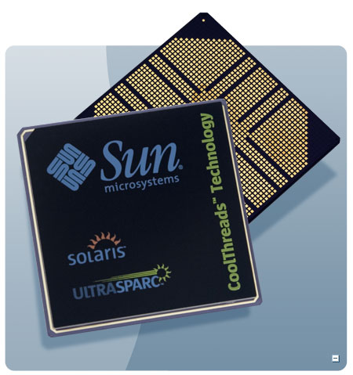
T1 (“Niagara”) - 2005
Target: Commercial server applications
High thread level parallelism (TLP)
Large numbers of parallel client requests
Low instruction level parallelism (ILP)
High cache miss rates
Many unpredictable branches
Frequent load-load dependencies
Power, cooling, and space are major concerns for data centers
Metric: Performance/Watt/Sq. Ft.
Approach: Multicore, Fine-grain multithreading, Simple 6-stage pipeline, Single Issue, Small L1 caches, Shared L2, 90nm

Slide 33
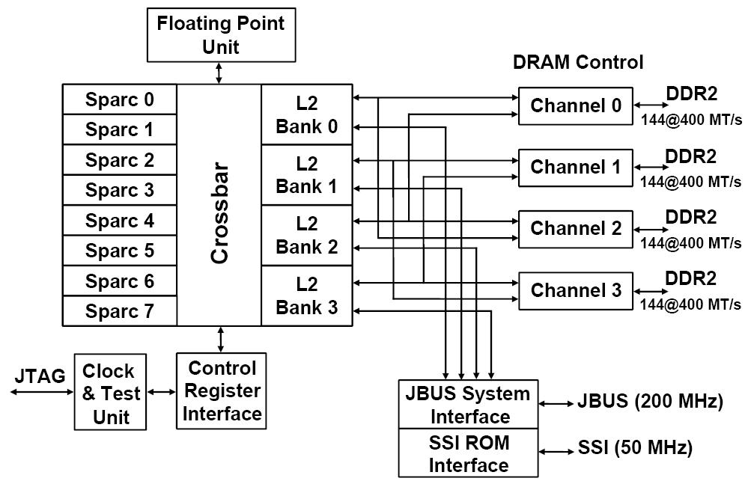
T1 Architecture
Also ships with 4 or 6 processors
Directory distributed into L2
33

Slide 34
T1 Fine-Grained Multithreading
Each core supports four threads and has its own L1 caches (16KB for instructions and 8 KB for data)
Switching to a new thread on each clock cycle
Idle threads are bypassed in the scheduling
Waiting due to a pipeline delay or cache miss
Processor is idle only when all 4 threads are idle or stalled
Both loads and branches incur a 3 cycle delay that can only be hidden by other threads
A single set of floating point functional units is shared by all 8 cores
floating point performance was not a focus for T1

Slide 35
CPI Breakdown of Performance
Benchmark | Per Thread CPI | Per core CPI | Effective CPI for 8 cores | Effective IPC for 8 cores
TPC-C | 7.20 | 1.80 | 0.23 | 4.4
SPECJBB | 5.60 | 1.40 | 0.18 | 5.7
SPECWeb99 | 6.60 | 1.65 | 0.21 | 4.8
Max IPC = 8 -- Is the T1 good?
Notes:
Although T1 is not getting 8 IPC, still much better than Superscalar approach with much lower complexity cost (resulting in lower area and transistor count)

Slide 36
Microprocessor Comparison
Processor | SUN T1 | Opteron | Pentium D | IBM Power 5
Cores | 8 | 2 | 2 | 2
Instruction issues / clock / core | 1 | 3 | 3 | 4
Peak instr. issues / chip | 8 | 6 | 6 | 8
Multithreading | Fine-grained | No | SMT | SMT
L1 I/D in KB per core | 16/8 | 64/64 | 12K uops/16 | 64/32
L2 per core/shared | 3 MB shared | 1MB / core | 1MB/ core | 1.9 MB shared
Clock rate (GHz) | 1.2 | 2.4 | 3.2 | 1.9
Transistor count (M) | 300 | 233 | 230 | 276
Die size (mm²) | 379 | 199 | 206 | 389
Power (W) | 79 | 110 | 130 | 125
2/27/2018

Slide 37
Performance Relative to Pentium D

Slide 38
Performance/mm², Performance/Watt

Slide 39
Niagara 2
Improve performance by increasing threads supported per chip from 32 to 64
8 cores * 8 threads per core
Floating-point unit for each core, not for each chip
Hardware support for encryption standards AES, 3DES, and elliptical-curve cryptography
Niagara 2 will add a number of 8x PCI Express interfaces directly into the chip in addition to integrated 10Gigabit Ethernet XAU interfaces and Gigabit Ethernet ports.
Integrated memory controllers will shift support from DDR2 to FB-DIMMs and double the maximum amount of system memory.
Kevin Krewell
“Sun's Niagara Begins CMT Flood -
The Sun UltraSPARC T1 Processor Released”
Microprocessor Report, January 3, 2006

Slide 40
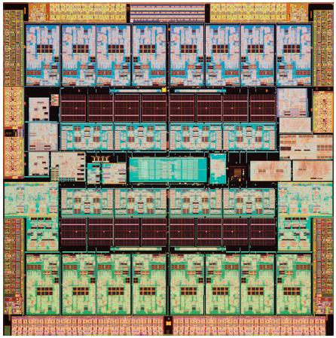
T3 - Rainbow Falls
Released 20 September 2010
16 cores x 8 threads/core
40 nm feature size
1.65 GHz
16 floating-point units
On-board cryptography with new Kasumi Bulk algorithm, supporting 12 embedded security industry-standard ciphers: DES, 3DES, AES, RC4, SHA1,SHA256, SHA384, SHA512,MD5, RSA to 2048 key, ECC, CRC32
Oracle T3 Series Data Sheet

Slide 41
And in Conclusion …
Snooping and Directory Protocols similar; bus makes snooping easier because of broadcast (snooping ⇒ uniform memory access)
Directory has extra data structure to keep track of state of all cache blocks
Distributing directory ⇒ scalable shared address multiprocessor ⇒ Cache coherent, Non uniform memory access
MPs are highly effective for multiprogrammed workloads
MPs proved effective for intensive commercial workloads, such as OLTP (assuming enough I/O to be CPU-limited), and large-scale web searching applications

